Slide 1
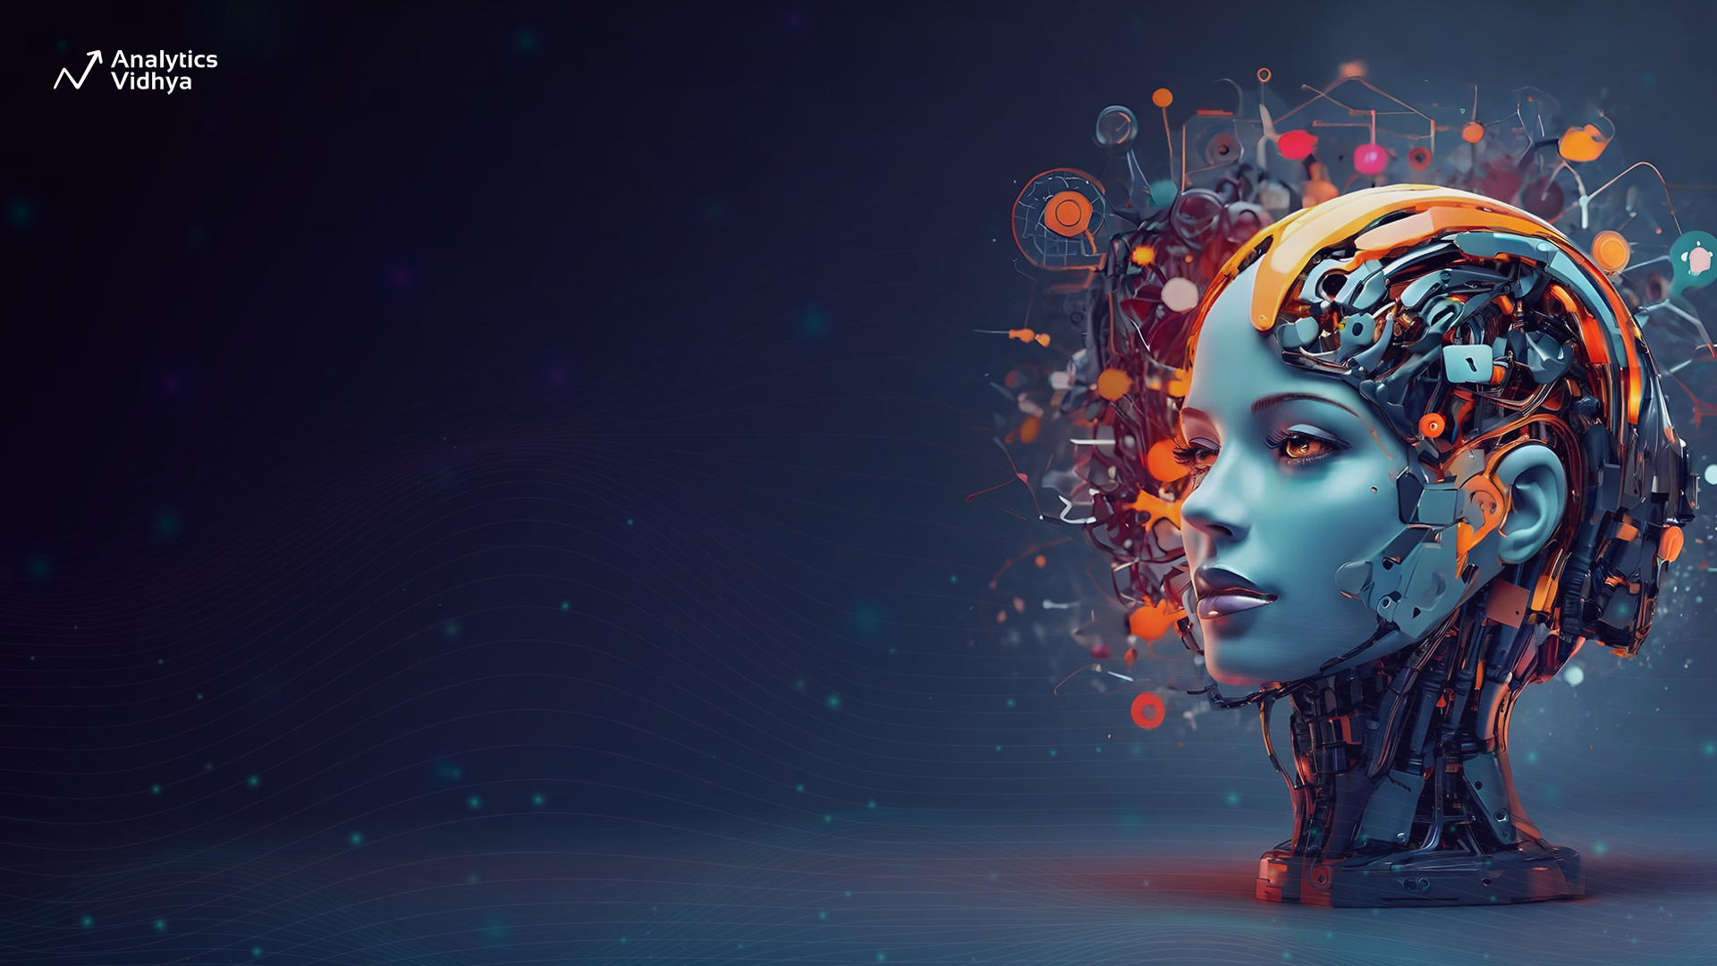
Multimodality in AG2
Apoorv Vishnoi
Head of Training, Analytics Vidhya
Notes:
Hi everyone, We have come a long way in our agentic journey covering every possible agent type that we can build in AG2 using unimodal data i.e., text. But what if we wish to work with data other than just text… well that is multimodality for you.

Slide 2
Multimodality
Ability of AI systems to process and understand different types of data - text, images, audio, video
Notes:
Multimodality refers to the ability of AI systems to process and understand information from multiple types of data, such as text, images, audio, and even video. Lets look at some real-world examples of Multimodality.

Slide 3
Multimodality
Examples of Multimodality
Image Captioning
Notes:
First is Image Captioning. It describes what’s happening in a photo.

Slide 4
Multimodality
Examples of Multimodality
Image Captioning
Visual Q/A
Notes:
Then we have Visual Question Answering (VQA) for Answering questions about an image, like "What is the color of the car in the picture?"

Slide 5
Multimodality
Examples of Multimodality
Image Captioning
Visual Q/A
Video Summarization
Notes:
Then we have video summarization which involves analyzing videos and providing concise summaries of key events.

Slide 6
Multimodality
Examples of Multimodality
Image Captioning
Visual Q/A
Video Summarization
Audio/Image/Video Generation
Notes:
Last is Audio/Image/Video Generation for Generating an audio, image or video file based on a prompt.

Slide 7
Multimodality in AG2
Multimodality in AG2
Audio
Visual
Text
Notes:
Currently, in AG2, multimodality enables agents to work with audio, visual and textual inputs, making them capable of tasks that require a combined understanding of these data types. Multimodal agents in AG2 can also interact with other agents in a group chat or nested chat.

Slide 8
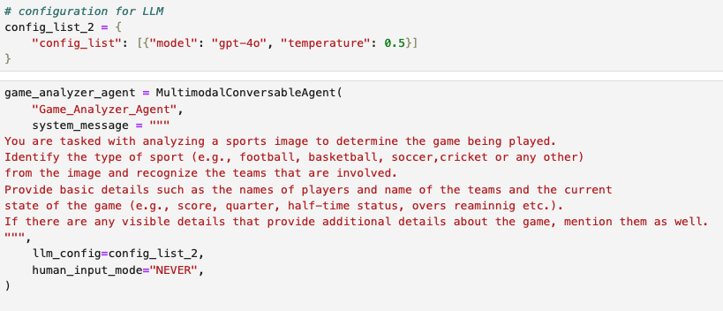
Multimodality in Python
Notes:
One key class to implement multimodality in AG2 is through the MultimodalConversableAgent Class. The MultimodalAgent is designed to work with Large Multimodal models like GPT-4o, Llava, Dall. E, and more. These models have built-in capabilities to handle both text and visual inputs natively.

Slide 9
Applications of Multimodality
Healthcare: Interpret medical images
Group Chat: Enhance customer experience with image based query resolution
Advertisement: Generate images based on brand guidelines
Notes:
Multimodal agents have applications across diverse industries like healthcare, e-commerce, and advertisement.
In healthcare, these agents can help with interpreting medical images,
In e-commerce, they can help enhance customer experience by strengthening image-based query resolution or improving product descriptions,
In advertisement, multimodal agents can help to generate images based on brand guidelines and more.

Slide 10
Thanks!
Notes:
This is all for the lesson, it's better to play with the images actually to understand the potential of these Multimodal agents. Let's do that in the next video!

